Slide 1
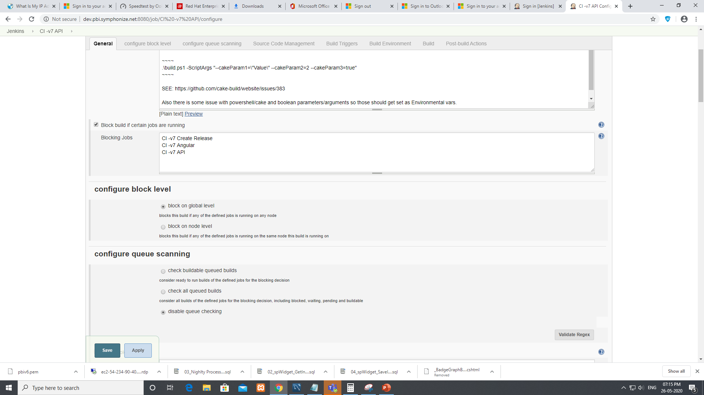

Slide 2
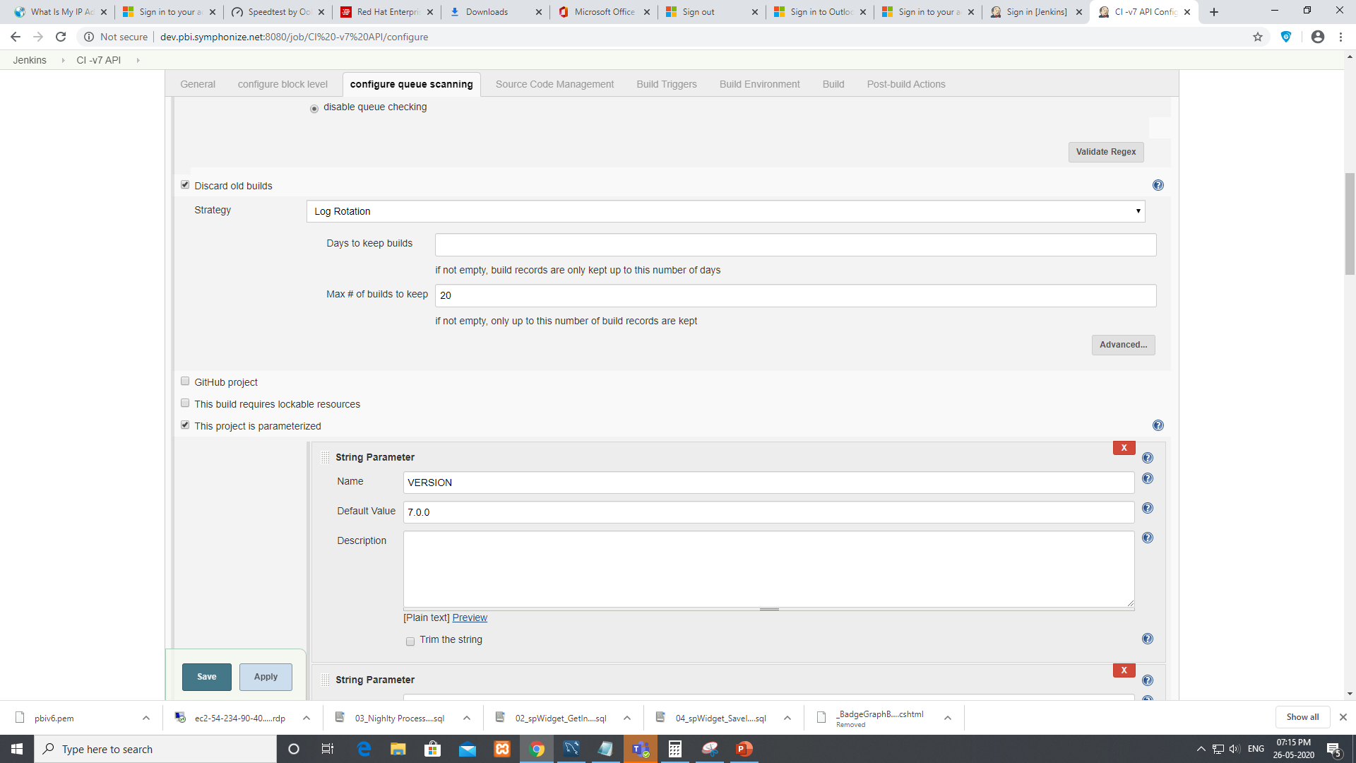

Slide 3
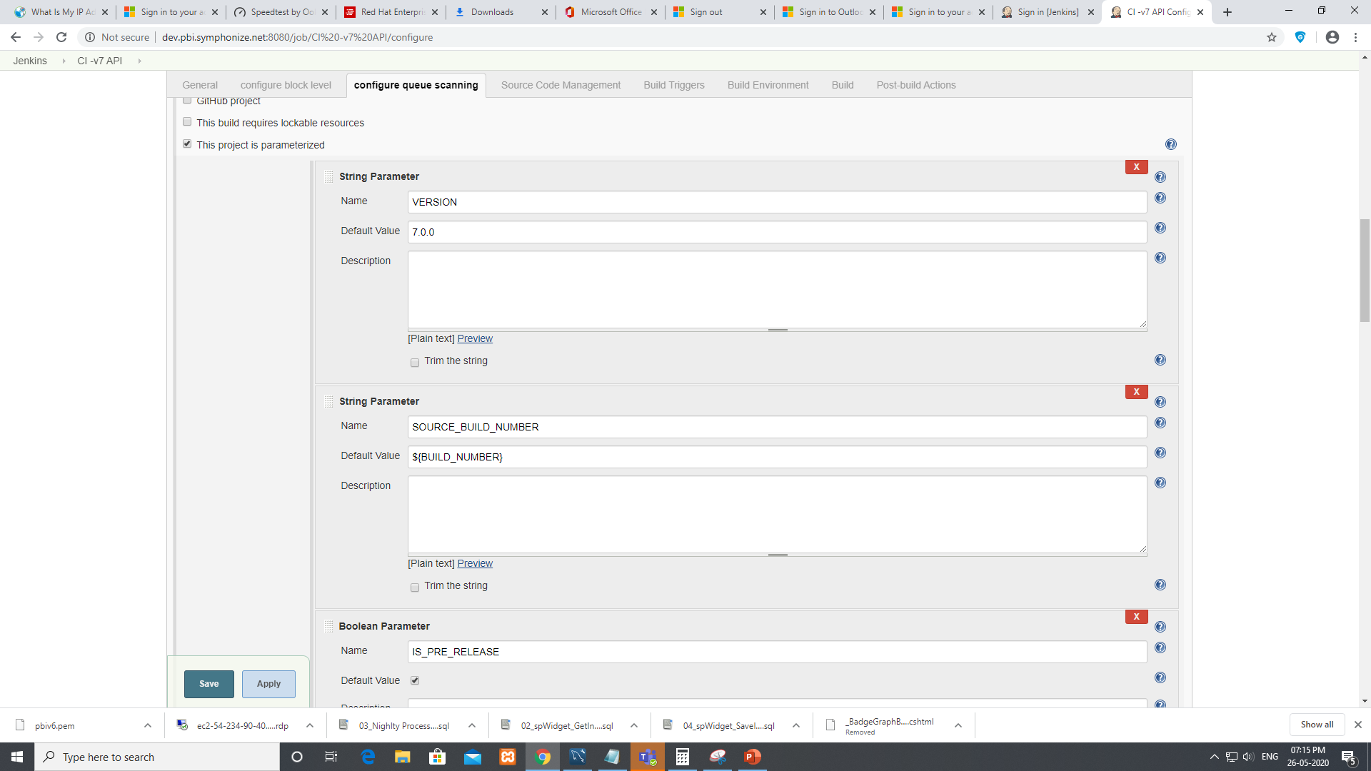

Slide 4
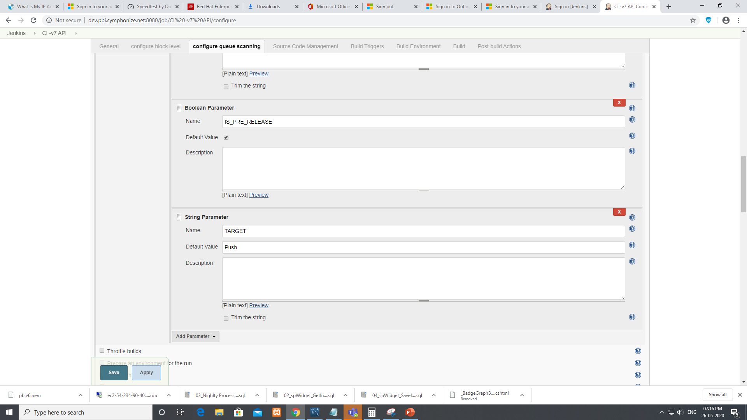

Slide 5
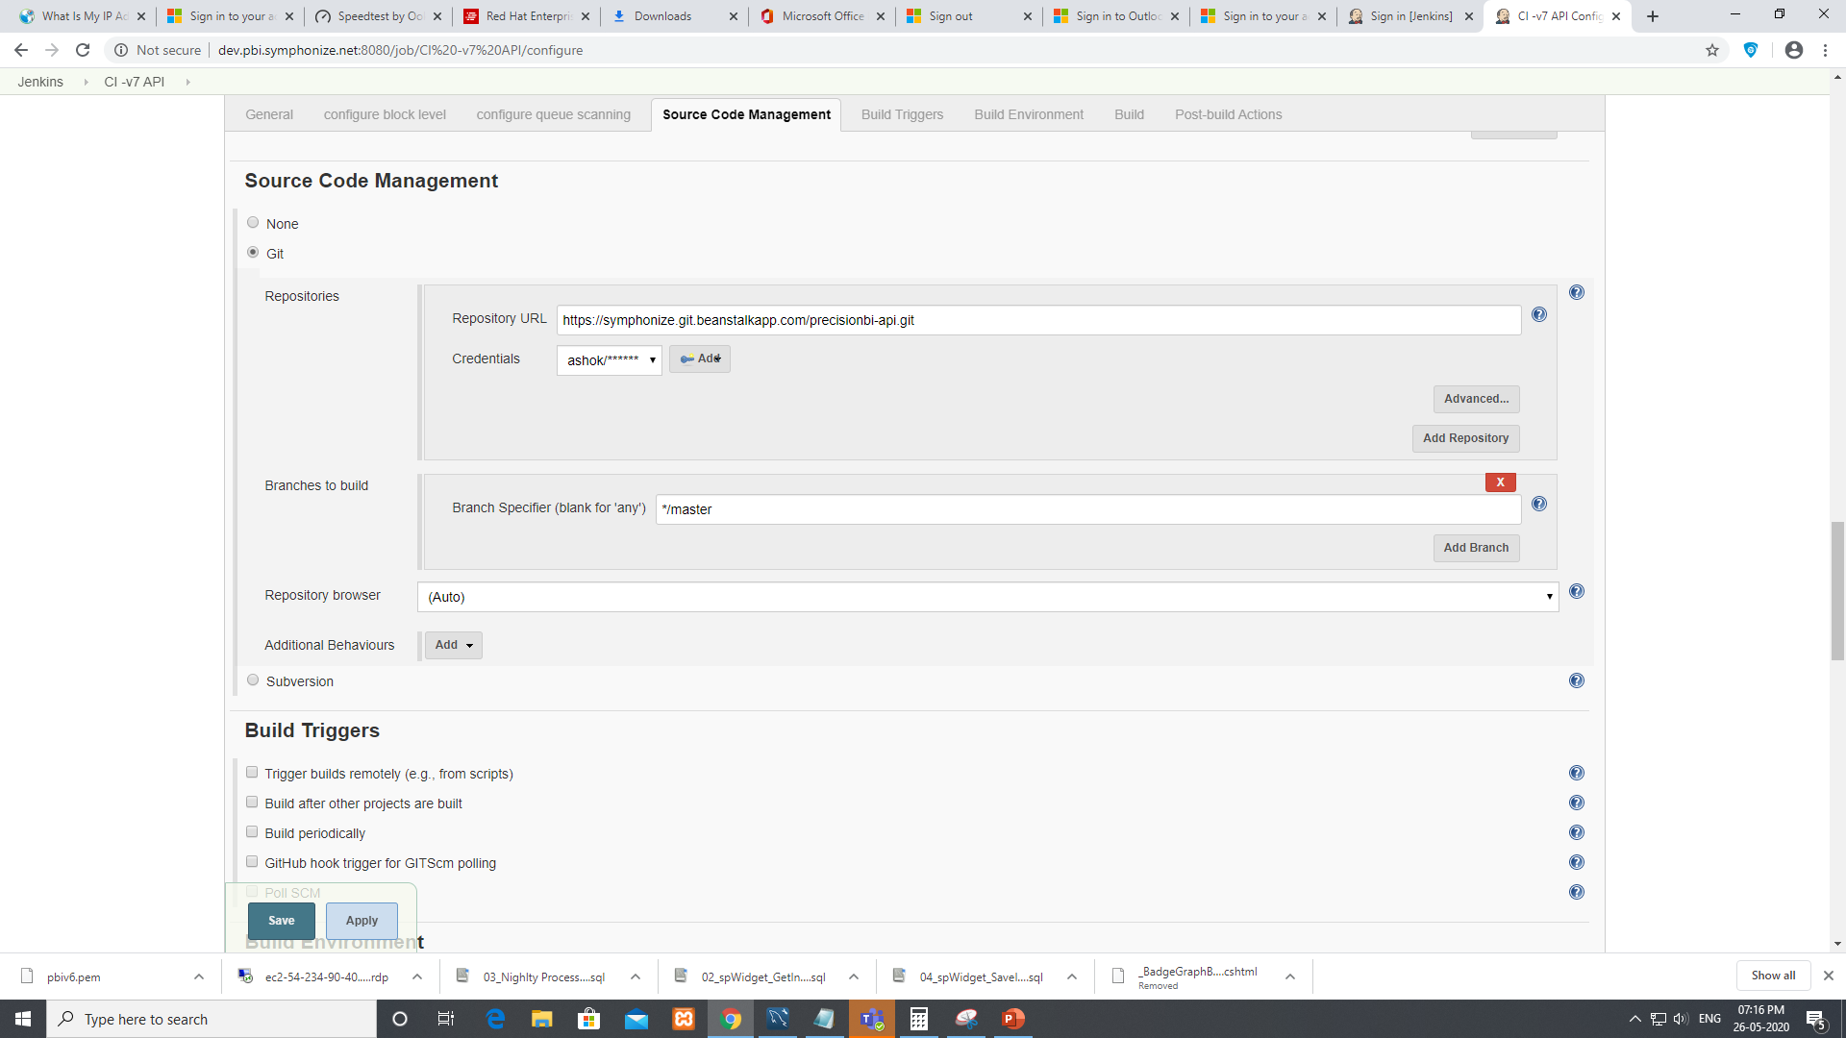

Slide 6
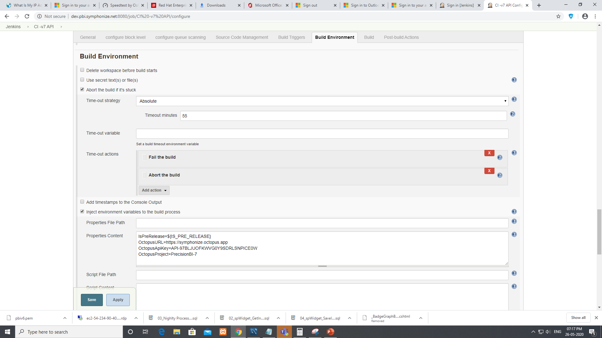
IsPreRelease=${IS_PRE_RELEASE}
OctopusURL=https://symphonize.octopus.app
OctopusApiKey=API-97BLJUOFKWVG0Y9SDRLSNPICE0W
OctopusProject=PrecisionBI-7

Slide 7
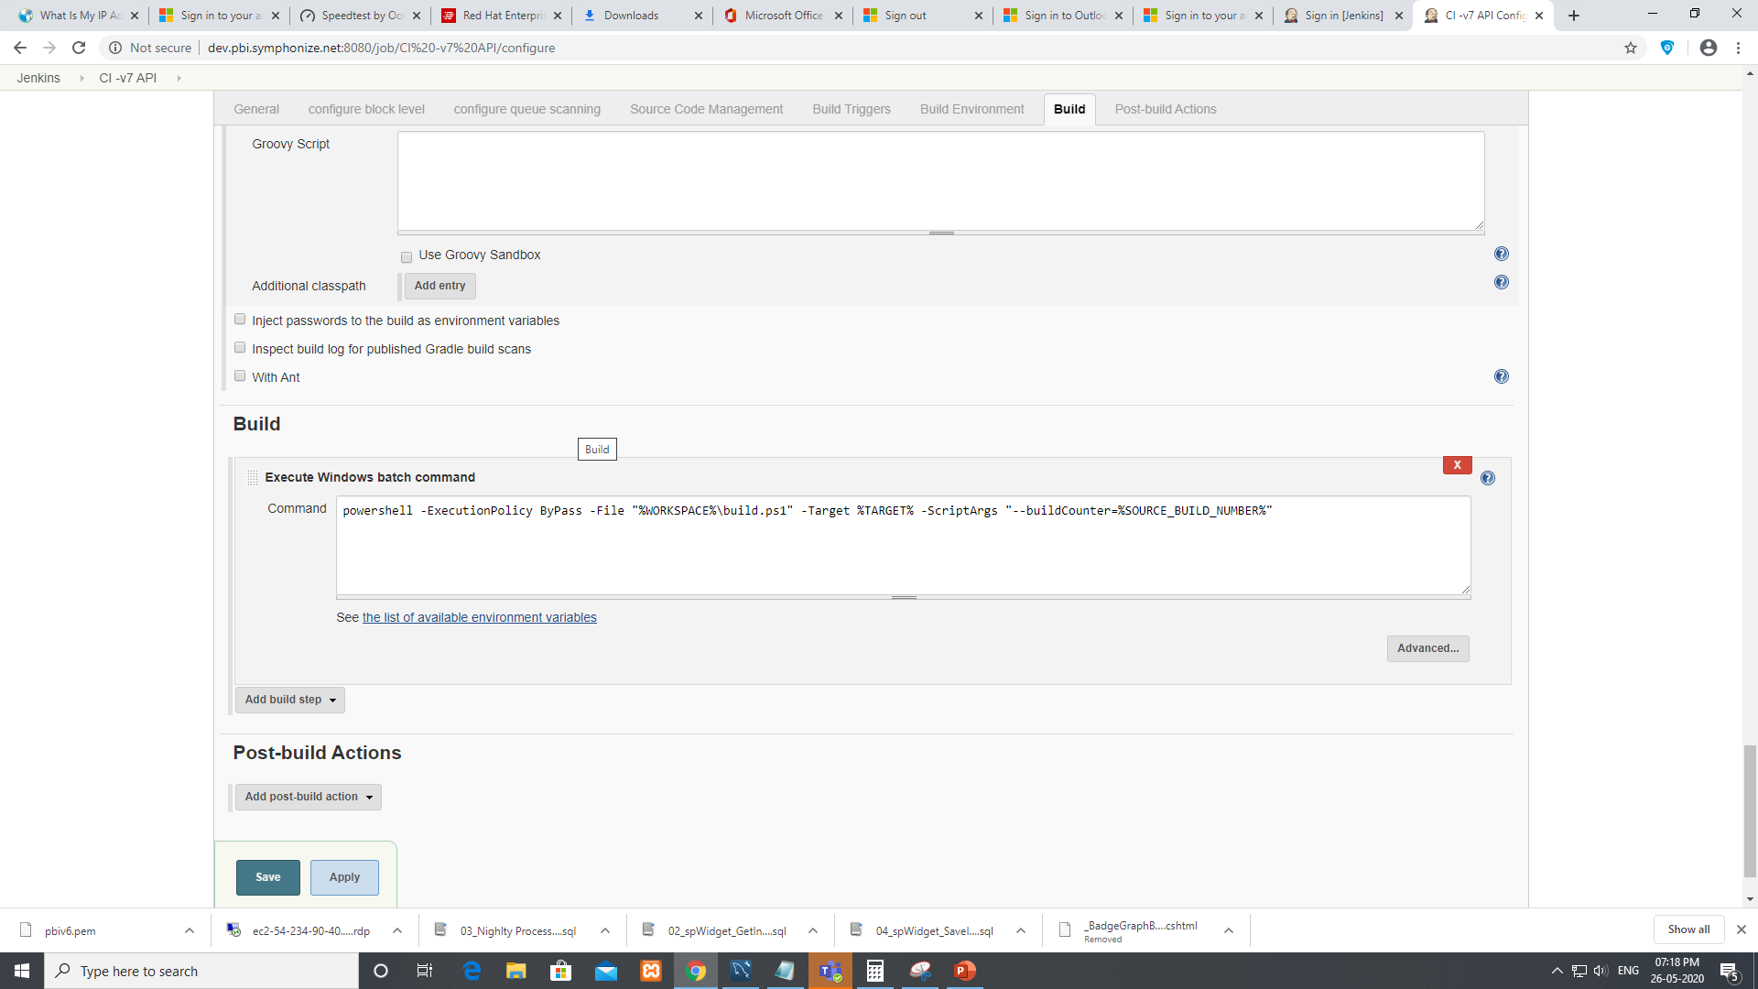
powershell -ExecutionPolicy ByPass -File "%WORKSPACE%\build.ps1" -Target %TARGET% -ScriptArgs "--buildCounter=%SOURCE_BUILD_NUMBER%"

